Slide 1
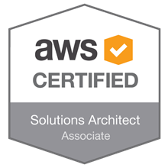
AWS- Solutions Architect
:- amir KhaN

Slide 2
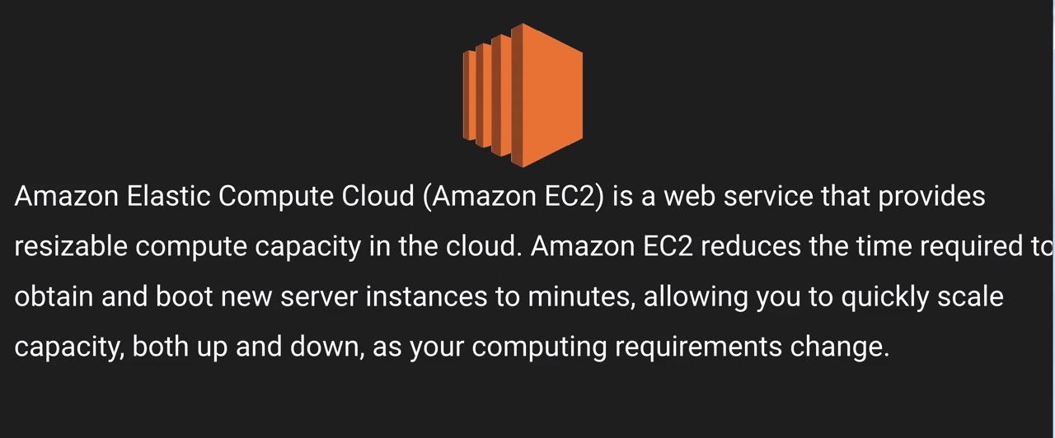
EC2
Elastic compute cloud is nothing but VM in cloud
This can be your linux, windows and you provision them on demand

Slide 3
EC2
Traditionally before cloud computing if i needed a database server i would go to different hardware providers and i would tell them my requirement (core,RAM,Hard disk, SSD)
Based on that they will quote prices and then you will contact your finance team to raise a PO they send PI and then they send that servers
It takes couple of weeks for the server to arrive at your place. once it arrives you have to rack and stack on your DC and you have to install the OS patch it according to the Organization security policies and this entire process would take months.
Post cloud computing you can instantly provision that by making an API calls to a browser
You can provision it within minutes and start experimenting
This is one of the important success behind startups as they don't have huge budgets to play around and experiment but with cloud they can provision an instance and experiment. post experiment they can decommission the machine and they just have to pay for the time they used the machine there is no upfront cost involved or any contract

Slide 4
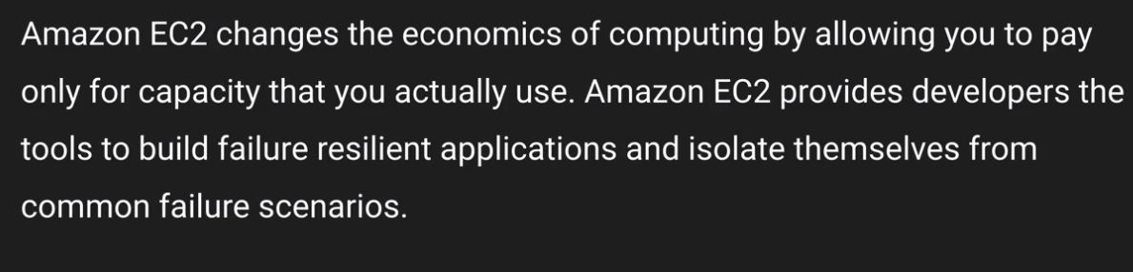
EC2
Different types of EC2 options
Spot Instances
If the spot price goes lower than your bid price you get the machine and if the spot price goes up again your machine is terminated
If Amazon terminate the machine you are not charged for that hour where in if you terminate the instance you will pay for the entire hour

Slide 5
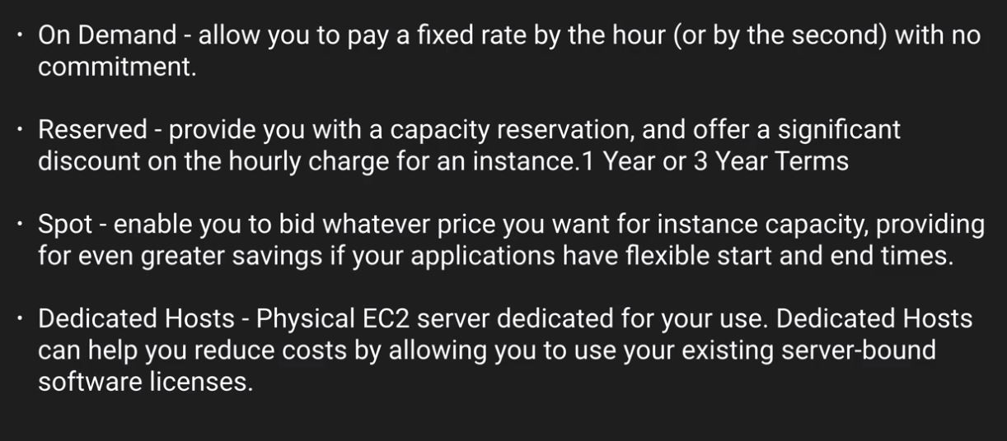
EC2
Different types of EC2 options
Note :- pay by the second is only for linux instance

Slide 6
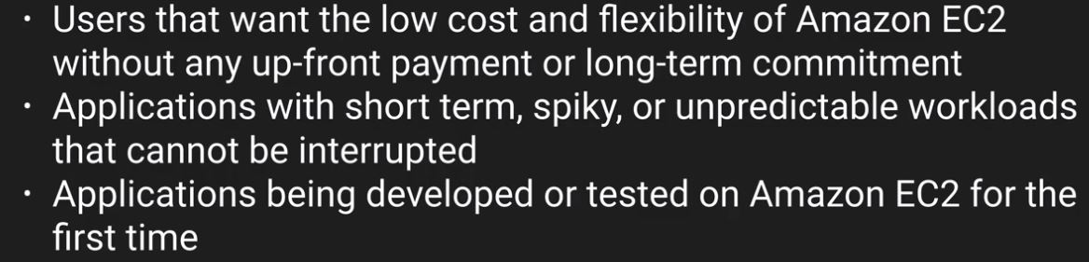
EC2
Different types of EC2 options
On-Demand

Slide 7
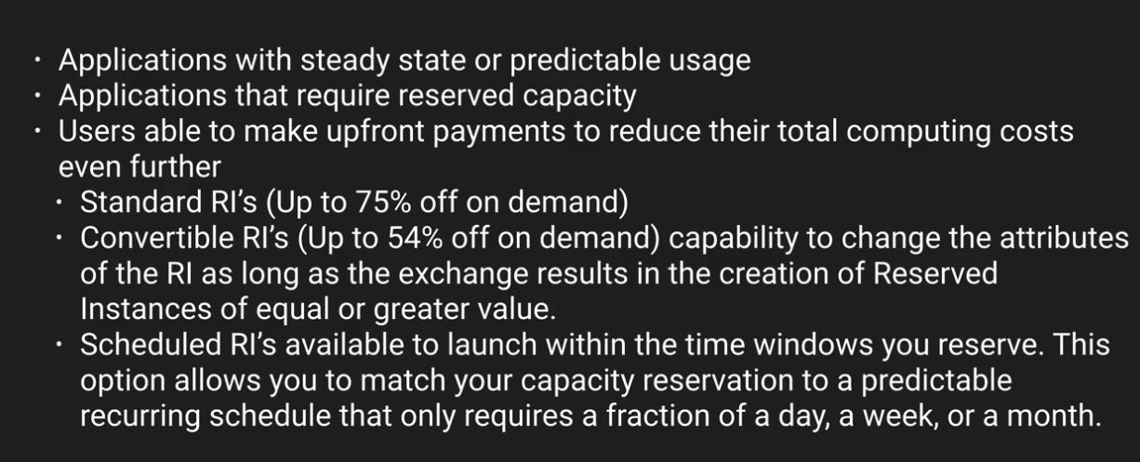
EC2
Different types of EC2 options
Reserved

Slide 8
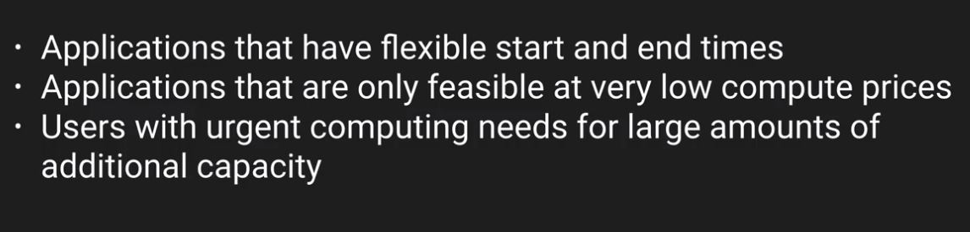
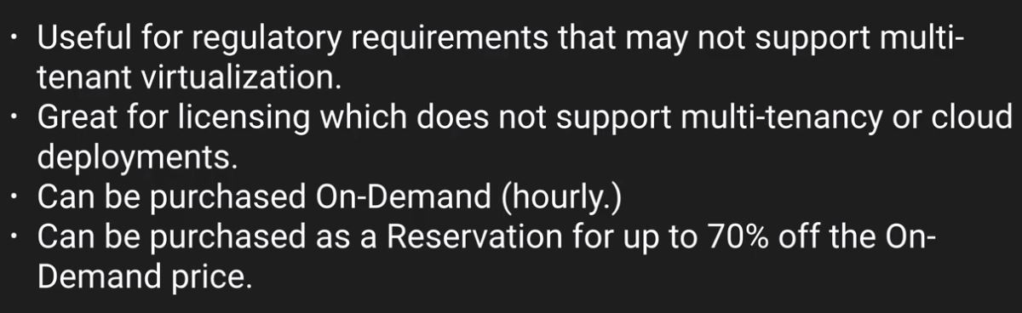
EC2
Different types of EC2 options
Spot
Dedicated

Slide 9
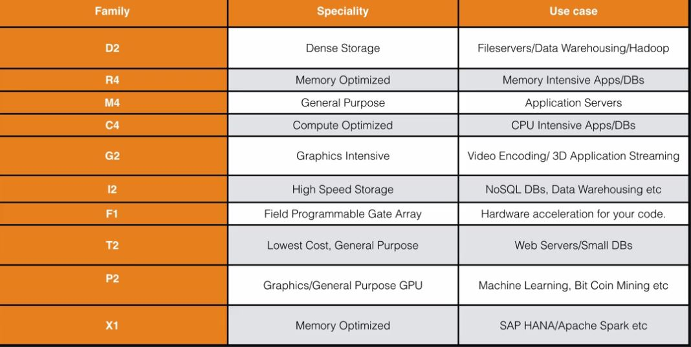
EC2
EC2 Families :- DrMcGiftPX

Slide 10
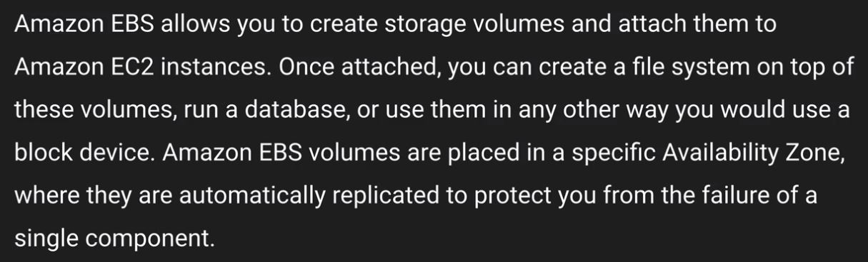
EBS
EBS allows you to create storage volumes. These are block based storage and you can install OS or Database on it
You can attach this to an EC2 instance consider this as an VHD.
Single component :- there is a backup storage array they are not replicated to different AZ

Slide 11
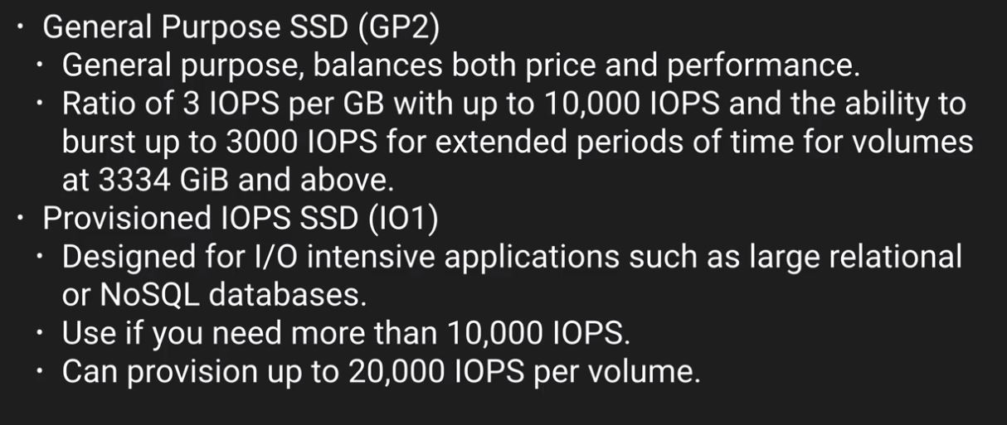
EBS
EBS Types
SSD

Slide 12
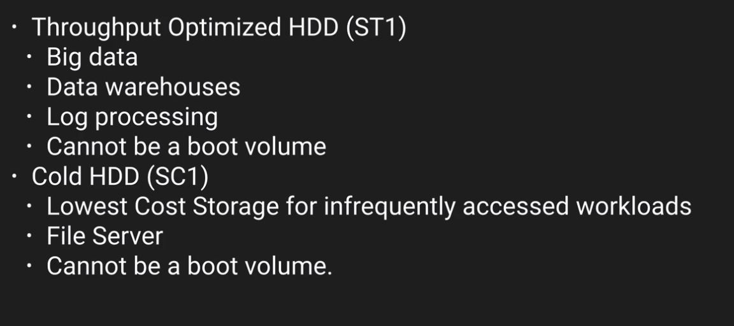
EBS
EBS Types
Magnetic
Note :- Data is written in sequence

Slide 13
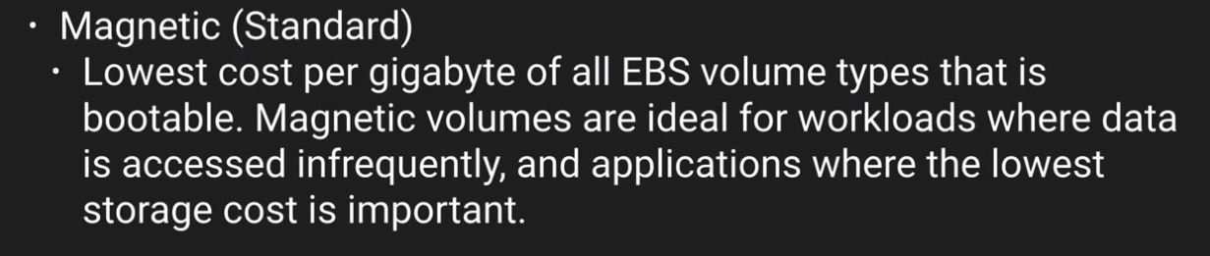
EBS
EBS Types
Magnetic
Note :- You cannot mount one EBS volume to multiple EC2 instance instead we use EFS

Slide 14
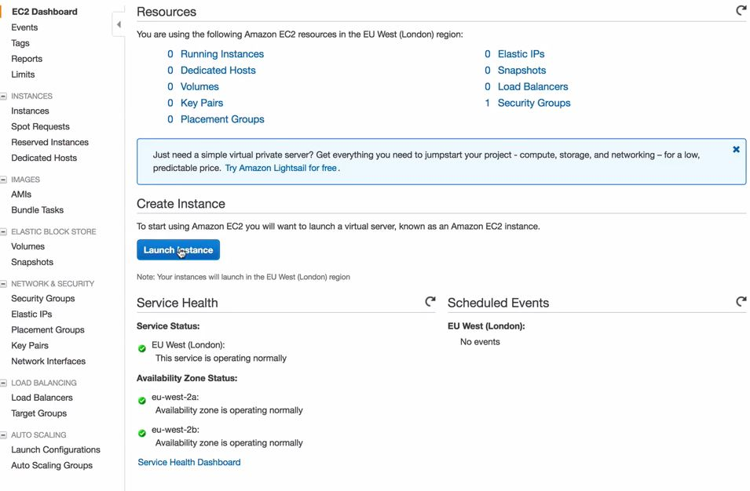
Launch an EC2 Instance
Login to the AWS console and then navigate to compute and then to EC2

Slide 15
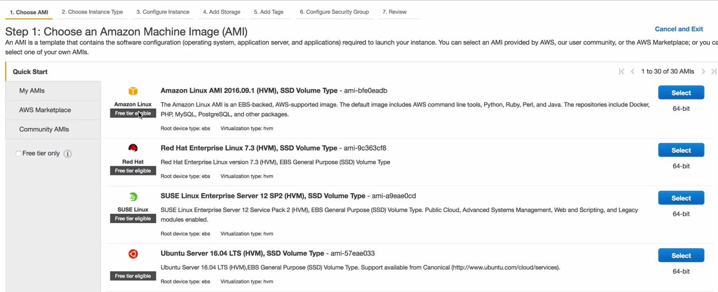
Launch an EC2 Instance
Choose an AMI

Slide 16
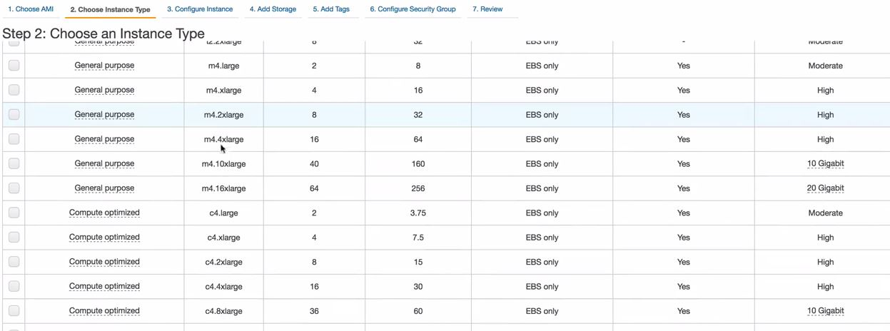
Launch an EC2 Instance
Choose an Instance Type

Slide 17
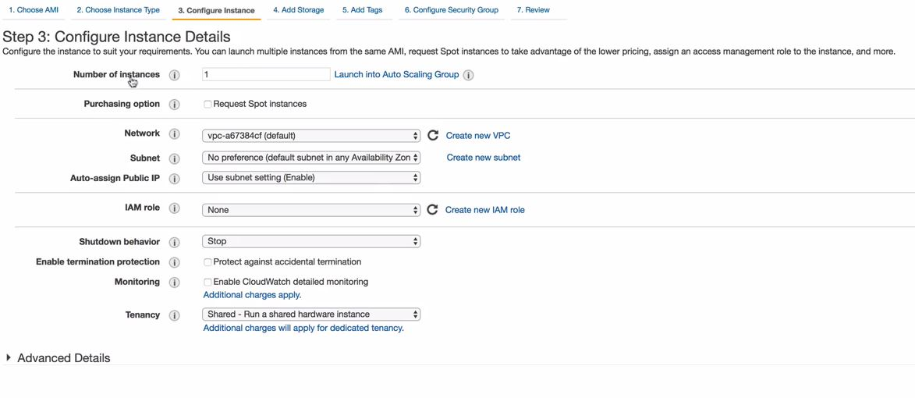
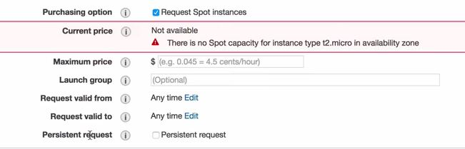
Launch an EC2 Instance
Configure an instance
Spot launcher configuration
Persistent request :- if you want this request to be repeated
In order to check for dedicated/shared we have to do that throuhg tenancy
Note :- when you create an account it creates one default VPC in every region

Slide 18
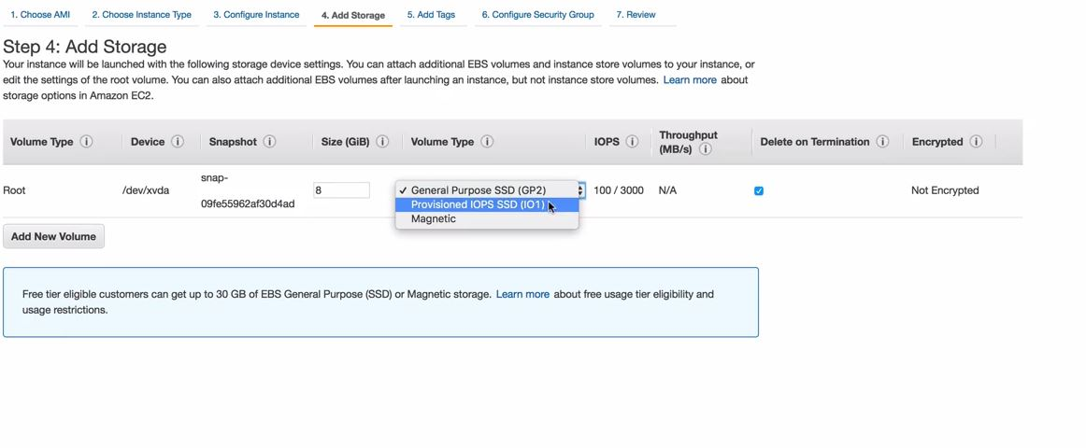
Launch an EC2 Instance
Subnet → CIDR address or in other words it refers to an AZ
1 Subnet →1 AZ
You cannot have one subnet go across two AZ
Adding storage to EC2 instance

Slide 19
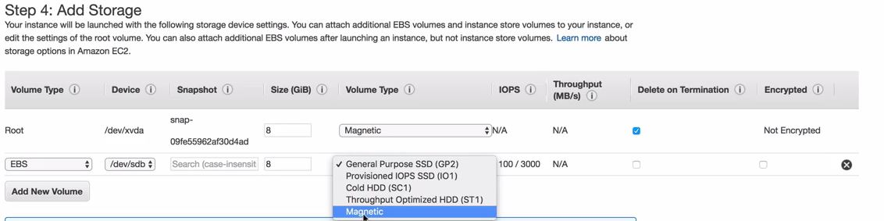
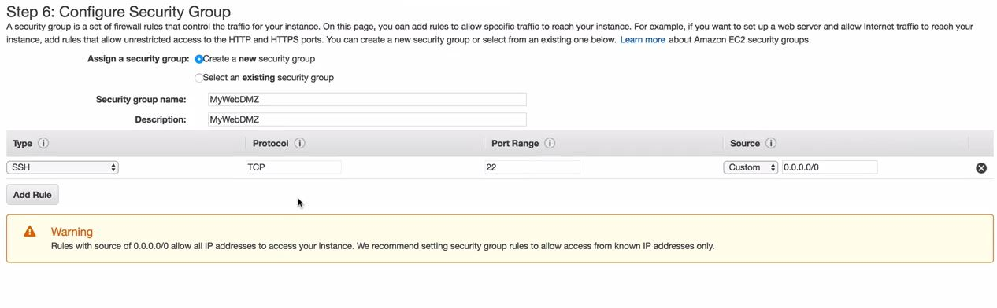
Launch an EC2 Instance
Root volume is where OS would be installed
By default root volume is deleted if the ec2 instance is deleted
Security groups = Virtual Firewall
You get one SG by default

Slide 20
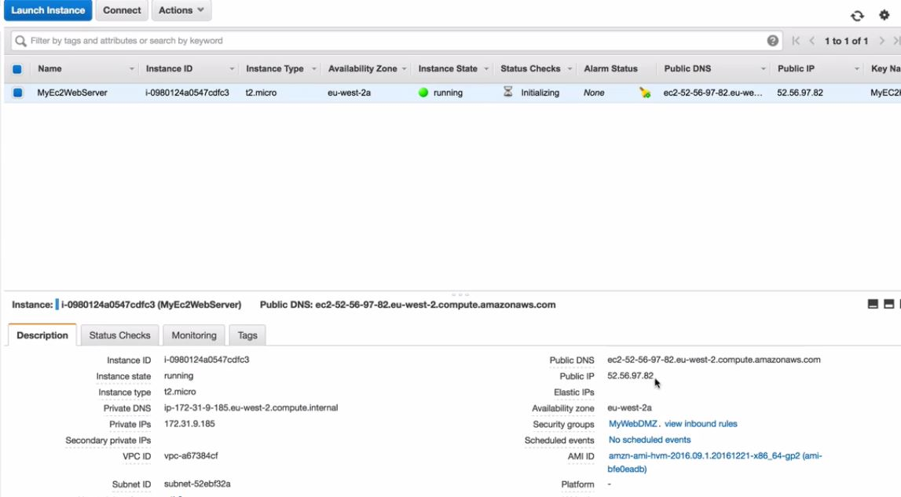
Launch an EC2 Instance
SG are stateful so any traffic is allowed would be allowed on inbound as well as outbound
You can also connection from a specfic IP or from another SG
Once you click on launch instance you will get an option to select a keypair
With keypair you access your instance
Public key is at the server and private key is with you and you use them in order to access the instance

Slide 21
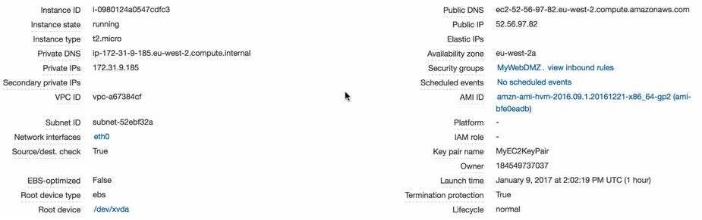
Launch an EC2 Instance
In order to ssh you can do it via terminal on mac or putty on windows
For mac you should navigate to the directory where you have the private key
Lock down the private key so that you can only see it
chmod 400 <keypair>
In order to SSH
ssh ec2-user@<public.ip> -i <keypair>
Once you are logged in to the machine you can do all the tasks that you want to do as a normal machine

Slide 22
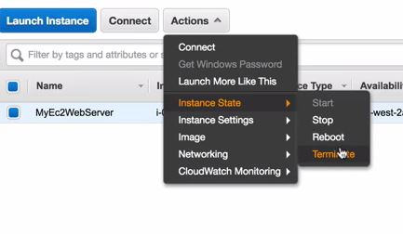
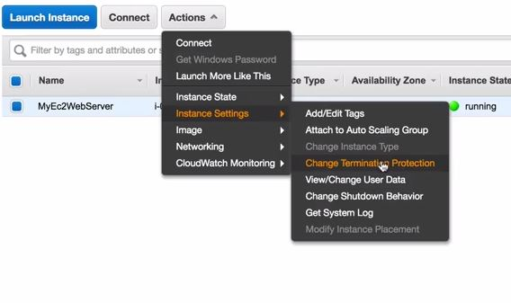
Launch an EC2 Instance
In order to terminate the instance →
In order to change termination protection →

Slide 23
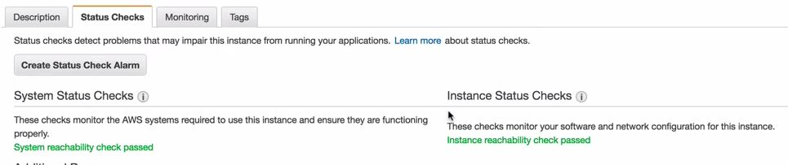
Launch an EC2 Instance
Status Checks
There are two different types of status check
System Status :- It verifies that your instance is reachable check if this check fails that means that the underlying infrastructure fails
You can reboot the instance in order to fix this as the instance would come on a new host after a reboot

Slide 24
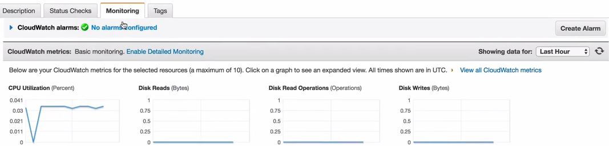
Launch an EC2 Instance
Monitoring
There are lot of metrics that are being monitored such as CPU utilization, disk read, network in and out

Slide 25
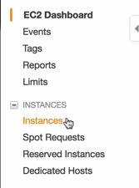
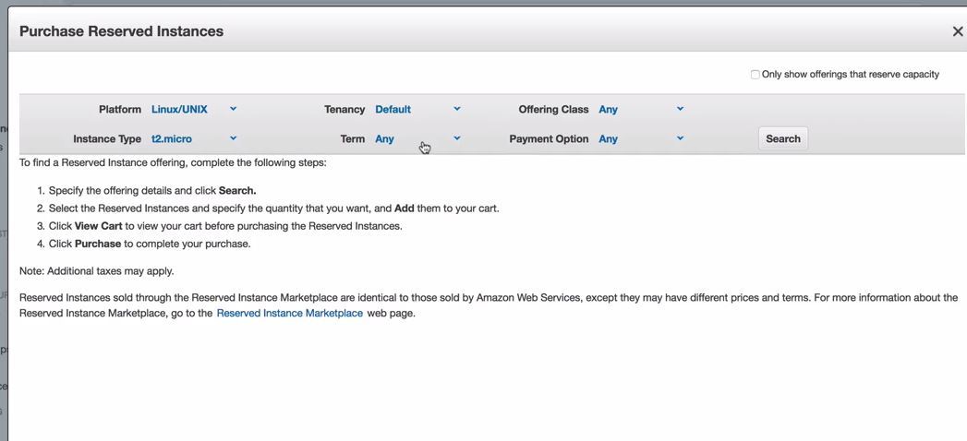
Launch an EC2 Instance
How to create a Reserved Instance →

Slide 26
Launch an EC2 Instance
Let's create another instance
Root volume cannot be encrypted by default for standard AMI but can be done for additional EBS
In order to encrypt the root device volume you can use third party tools like bit locker or create an AMI or create a copy of that EBS and while creating a copy encrypt that. We will check this in another lab
Terminate protection is turned off by default
On an EBS backed instance the root EBS volume gets deleted by default on termination

Slide 27
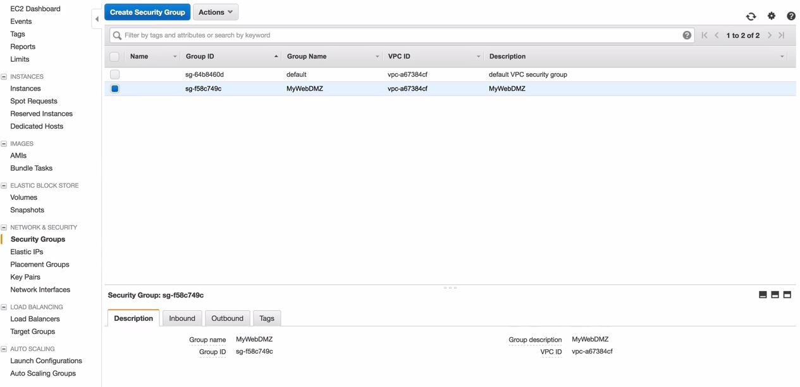
Launch an EC2 Instance
Security groups
These can be referred to as virtual firewall when you first launch from an ec2 instance you can attach more than 1 SG to it
Let's create an EC2 instance now and make it as a web-server

Slide 28
Launch an EC2 Instance
Security groups
By default everything is allowed outbound and denied all inbound
Any rules changes made to a SG would take effect immediately
SG is stateful, even if we don't have any outbound rules anything is which is allowed inbound would be allowed back out
Everything is blocked by default in a SG
With SG you cannot deny traffic to an specific IP or port
In the default SG the rules says that any instance that are behind the SG would be able to interact each other
If multiple SG are attached to an instance all rules would add up
You can attach SG on the fly to an EC2 instance

Slide 29
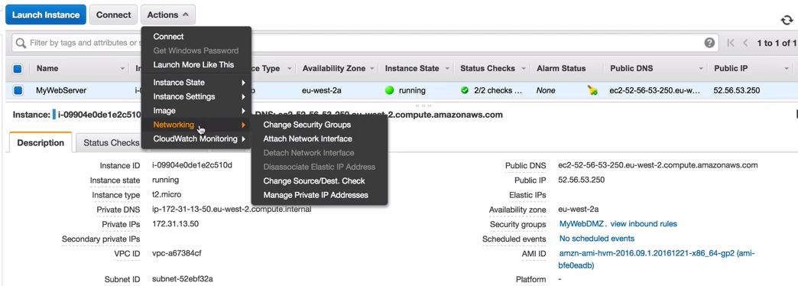
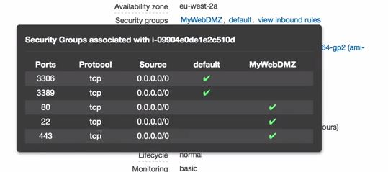
Launch an EC2 Instance
Security groups
You can have any number of instances behind an SG
All the rules would add up, there is no deny rules.

Slide 30
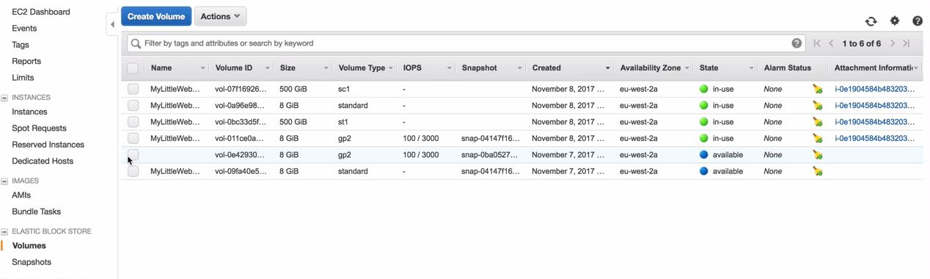
Launch an EC2 Instance
EBS
Add some EBS to the instance now
You cannot mount an EBS volume which is in another AZ and the instance is in another AZ
You can check the root device volume as it is provisioned from a snapshot

Slide 31
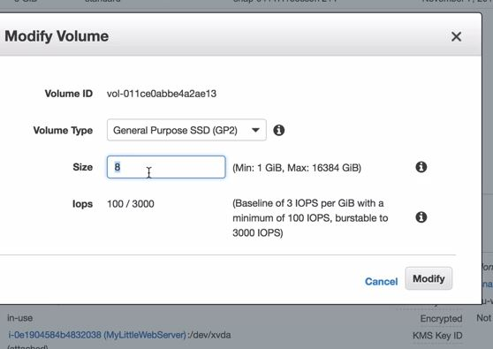
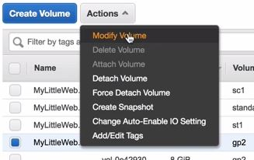
Upgrade EBS Volumes
This can be done on the fly and you don't even have to stop the machine
Note :- You cannot modify standard magnetic volume

Slide 32
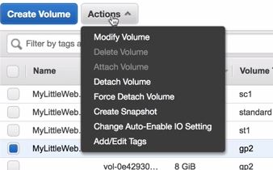
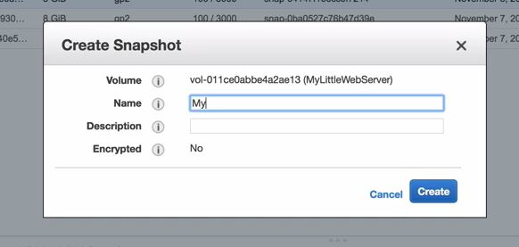
Upgrade EBS Volumes
Create same volume in a different AZ
In order to create the same copy of the volume in another AZ we first have to create a snapshot
We cannot encrypt the snapshot while creating it from a non encrypted volume

Slide 33
Upgrade EBS Volumes
You can copy the snapshot to another region this can be same too and then while copying you can encrypt it
We can create a volume from the snapshot in a separate AZ and attach it over there
Then you can create a new image and boot a new instance
In order to boot a new instance in a different AZ
Create a snapshot of the running instance by stopping it first and then copy it over and then create an image and boot a new instance
You can also directly create an image from the running instance from the actions tab
Snapshots exist in S3
These are point in time copies of a volumes
Snapshots are incremental
NOTE :- Snapshots of root device volume and creating an image we can boot an instance from that image since the OS is on the root device volume

Slide 34
Upgrade EBS Volumes
Snapshots of encrypted volumes are encrypted and volumes restored from encrypted snapshots are encrypted
You can share the snapshots only if these are unencrypted/made public or share that with other AWS accounts
Encrypting root device volumes
Let's stop the instance as we want to take a snapshot
Let's go to volumes and create a snapshot once the snapshot is created we have to copy it and select the option to encrypt
Once the snap is created we have to create an image from that and then we can create an instance
The instance that we would create would have it's root device volume as encrypted
AMI types
EBS volumes/ Instance store
There are two different types of root device volumes

Slide 35
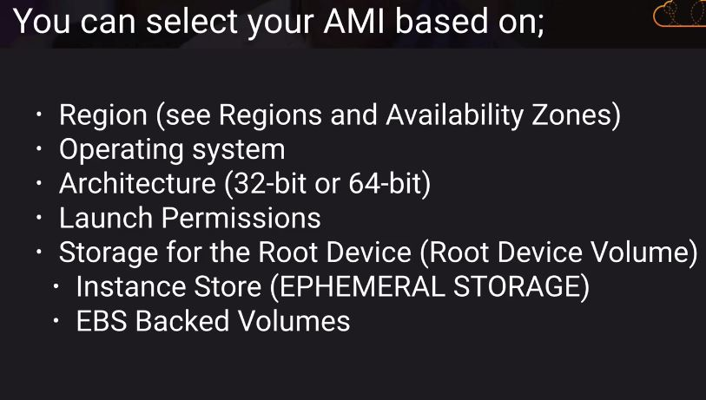
AMI Types
You will get instance store root device volume in community AMI
You cannot attach an instance store volume once the instance is launched
You can attach only one more instance store volume while launching the instance
Cannot encrypt additional instance store volume despite it not being a root device volume
Instance store backed instance you cannot stop the instance while With EBS you can stop the instance

Slide 36
AMI Types
In case the underlying host fails by checking the status check by stopping and starting it again and the machine would be provisioned on another host
In case you have instance store and the underlying host fails you cannot get the machine
Instance store volumes does not shows up in the console
You can also detach the root volume of an EBS backed instance where in there is no option available with instance store
With EBS backed instance root device volume is created from an EBS snapshot
With instance store backed root device volume is created from a template stored in S3
You can keep root device volume for EBS backed instance
You can reboot both of them

Slide 37
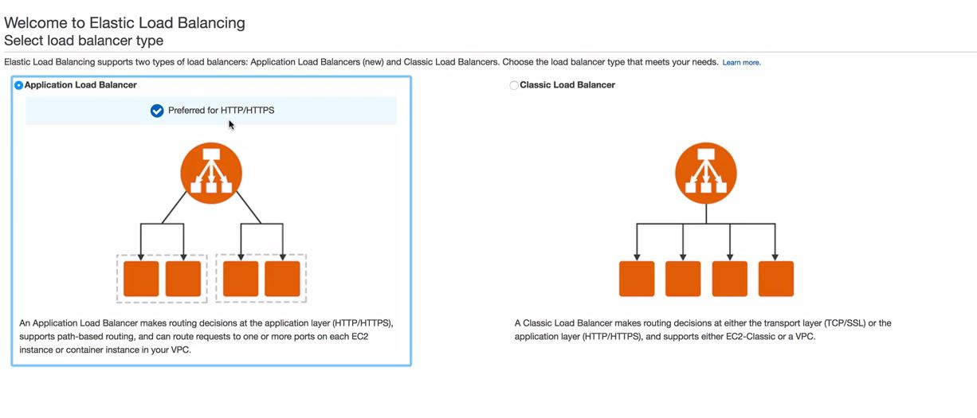
Elastic Load Balancer
Load balancer would balance the loads across the backend instances
Create an instance in case that is decommissioned
SSH in to the instance
Make sure httpd is running
Navigate to the apache directory, and create health check file
This file would be used by the load balancer to check if the instance is up
From EC2 dashboard create a load balancer
There are two types of load balancer →

Slide 38
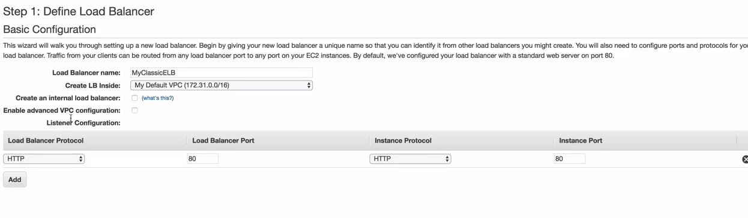
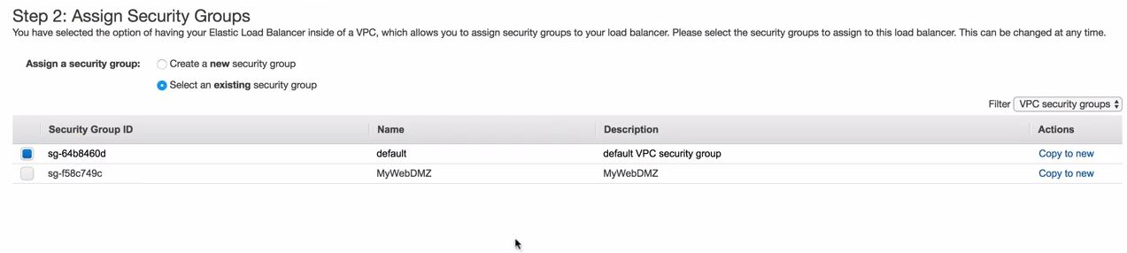
Elastic Load Balancer

Slide 39
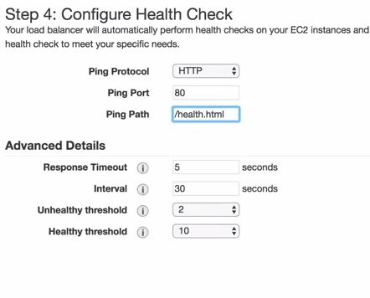
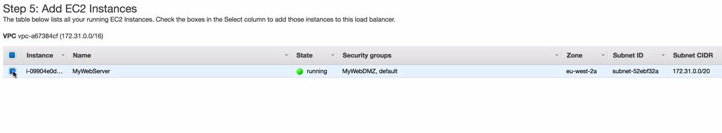
Elastic Load Balancer

Slide 40
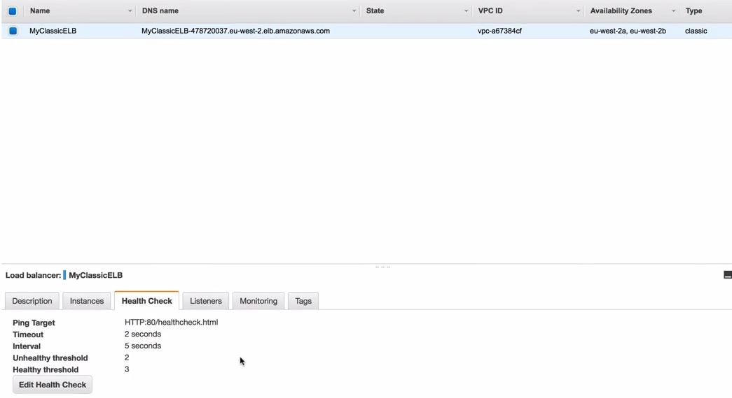
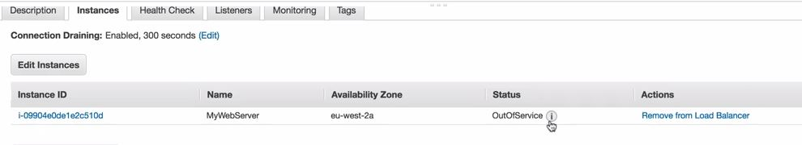
Elastic Load Balancer

Slide 41
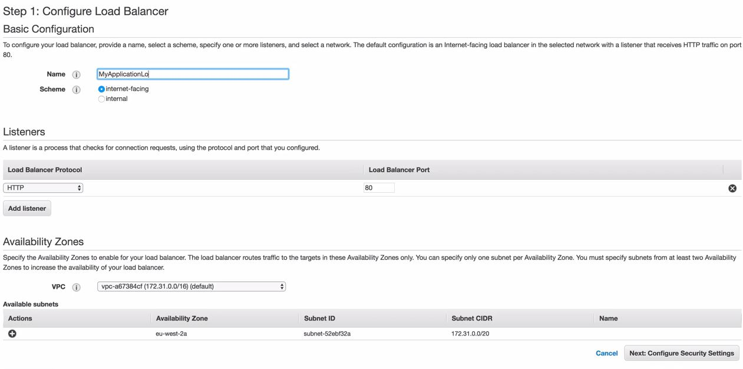
Elastic Load Balancer
Let's try to create a failover
Remove the healthcheck file and load balancer would detect that the instance is not healthy and would not route traffic to the instance and the instance would go out of service
if you cut and paste the DNS name this should essentially route the traffic to your instance that are serving the content
Let's create an Application load balancer
Note :- You will not get a IP address for an ELB

Slide 42
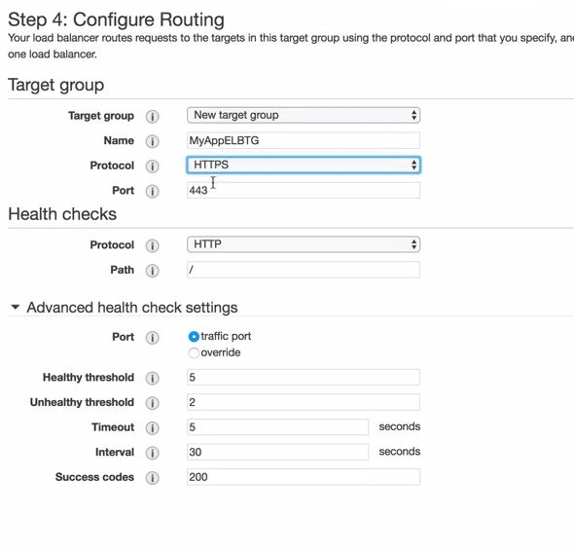
Elastic Load Balancer
Application load balancer
You can also use LB in conjunction with route 53
Note: you can do healthcheck on the traffic port also you can override that

Slide 43
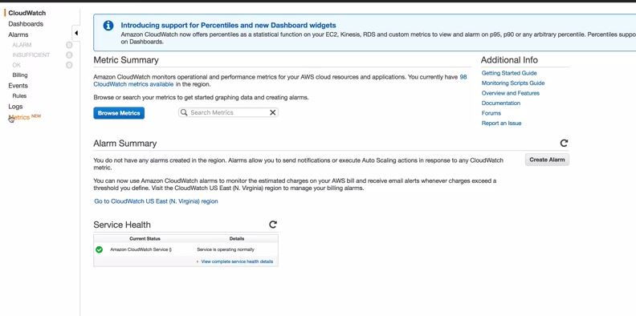
Cloudwatch
Cloudwatch is basically used to monitoring
Let's login to the console and navigate to cloudwatch
Cloudwatch monitors different metrics for aws resources
These metrics can be default or you can also customize metrics

Slide 44
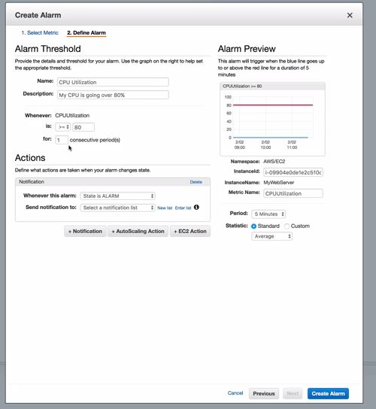
Cloudwatch
Create a dashboard and add widgets
We can also create an alarm using cloudwatch

Slide 45
Cloudwatch
You can also track events using cloudwatch
Cloudwatch helps you to respond to state changes in your AWS account
When resources changes state they create an event you can use cloudwatch and create a rule to respond to this event
You can also use logs to monitor instances at the application level
You install an agent on your instance and that instance would send the data to cloudwatch
example :- kernel logs
AWS CLI
You can install that on your local machine or on your ec2 instance
Amazon linux AMI has AWS CLI pre-installed in it
We can access the resources using CLI by programmatic access
let's SSH into the instance and then in order to access aws resources using AWS cli
# aws configure
# access key
# secret key
# region

Slide 46
AWS CLI
Once done you should be able to access the resources depending on the permissions of the user whose acceess key id was used
in order to check on help
aws <service> help
aws is used to invoke the CLI
This all looks good however there is a drawback to it as the instance on which we have configure the credentials will save the credentials locally on the machine
So in case if anyone gets hold of our machine they can compromise the credentials and use it elsewhere
Hence in order to access any other AWS resource from a resource we should use roles
Credentials are stored in (~/.aws/credentials)

Slide 47
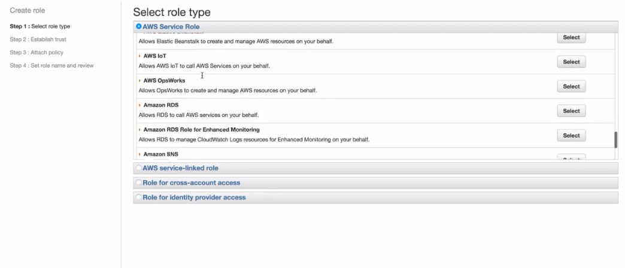
IAM Roles
Roles are a part of IAM and you can create a role in order to provide access to one AWS resource to another
AWS service roles :- are the services that can assume roles within your AWS account
AWS service linked roles :- this is for bots section
Cross account access :- roles to access service between account you own or someone else aws account
Select the kind of role and then attach a policy to that role
As IAM is global hence role is global

Slide 48
IAM Roles
Now you can attach roles to running instances, also you can attach roles while creating the instance
let's do that and create a new role and attach to an instance and try to use roles in order to access other aws resources
Using bootstrap scripting
Bootstrap script can be passed to ec2 instance as text file while creating an ec2 instance in the advanced section
Pre-requisite
Create an HTML page
Now create a bucket where we will save our html file
Upload the file to the bucket
Create a role in order for our ec2 instance to access S3
Now create an EC2 instance and attach this role and then write the steps for our bash script

Slide 49
Using bootstrap scripting
Interpreter #!/bin/bash
First step what we do is update the package
then install apache
then copy the content from the bucket to the html directory
run the service
make service permanent
Instance metadata
You can get the instance metadata through the below URL
curl http://169.254.169.54/latest/meta-data/

Slide 50

Autoscaling Groups
Autoscaling groups is defining a group that would scale up or down as per the rules defines in that group
In order to setup autoscaling groups we would need a launch configuration
We need to create a healthcheck file, this would be used by the autoscaling group to check the status of the instance
Launch configuration can be found under the EC2 dashboard
It's essentially the same steps that you would do while creating an EC2 instance

Slide 51


Autoscaling Groups
Once the launch configuration is done it will take us to the auto-scaling option
Group-size :- is the number of instance this autoscaling group would start with
Then select the VPC and then select the AZ
1 autoscaling group can span in one region only
it cannot provision the instance in another region
You can use route 53 and configure failover routing policy in case the entire region is down.

Slide 52


Placement groups
Now placement groups can span multiple AZ few use cases are hadoop cluster
Important key point for placement groups

Slide 53


EFS
Basic advantage of efs/ebs is you can mount efs to multiple ec2 instance
You don't pre-provision any storage
EFS Features

Slide 54

Create EFS
How to attach an EFS to a machine
You have to login to the machine first
in order to test this provision two ec2 instance and then attach EFS to them
Note :- in order to mount efs to an instance the instance and EFS should be in the same SG

Slide 55

Create EFS
You can also use user level permissions and directory level permissions
Directory level permissions would be same across all the ec2 instance

